Slide 1








THE EXPENSE TRACKER APP

Slide 2

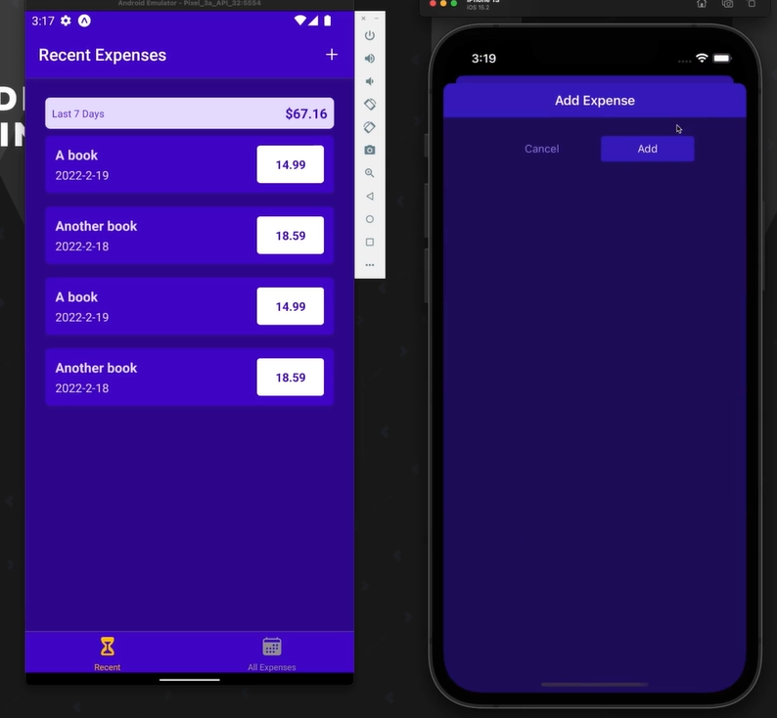

MODULE INTRODUCTION
-The Expense Tracker app will allow users to register, add, view, edit, and delete expenses.
-We will add:
navigation and multiple screens.
layouts and styles
manage a local and app-wide state,

Slide 3




The starting setup
The app will consist of three main screens:
All Expenses
Recent Expenses
Manage Expenses

Slide 4
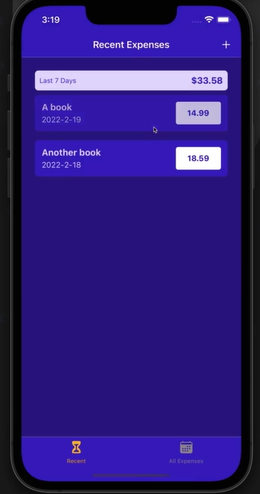
Recent Expenses Screen
This screen will show the user's recent expenses.

Slide 5
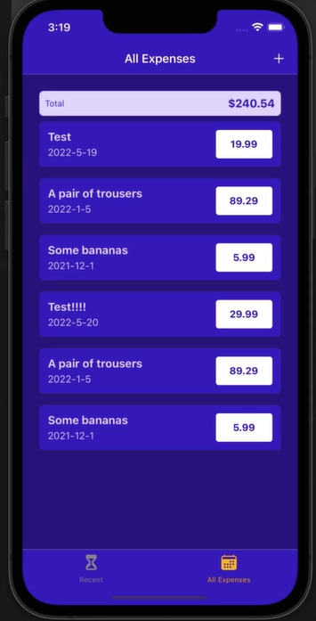
All Expenses Screen
This screen will display all the expenses.

Slide 6
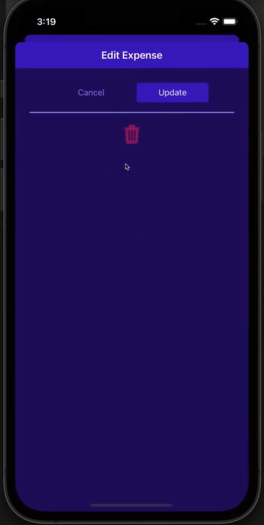
Manage Expenses Screen
Here, users will manage their expenses, including adding new ones, editing, or deleting.

Slide 7

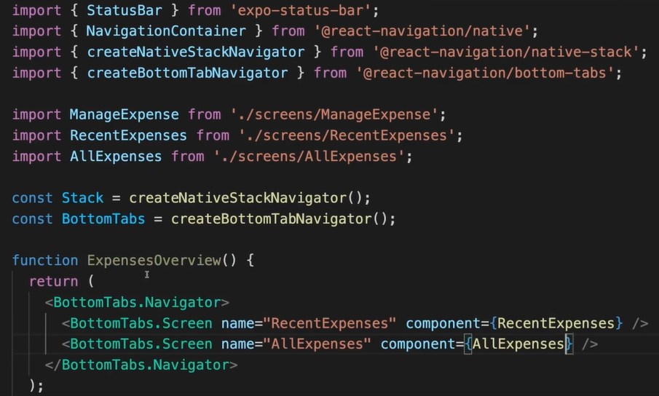
ADDING NAVIGATION & CONFIGURING NAVIGATION
- Import the necessary components: Import the required components from your navigation library (createNativeStackNavigator,...)
- Define & Import the screen components you want to navigate between (ManageExpense, RecentExpenses, AllExpenses)
How to navigate between 2 screens?
#1 Navigation Setup

Slide 8
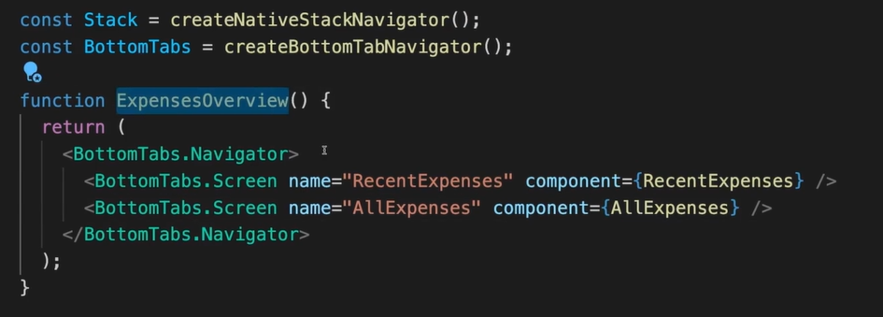
ADDING NAVIGATION & CONFIGURING NAVIGATION
- Create a stack/bottom-tab navigator: Use createNativeStackNavigator & createBottomTabNavigator
Create a function (ExpensesOverview) that uses the const BottomTabs and allows us to switch between All Expenses Screen and Recent Expenses Screen
#1 Navigation Setup

Slide 9

ADDING NAVIGATION & CONFIGURING NAVIGATION
npm install @react-navigation/native
npm install @react-navigation/stack
npm install @react-navigation/bottom-tabs
Don’t forget to install the related libraries before import them
#1 Navigation Setup

Slide 10

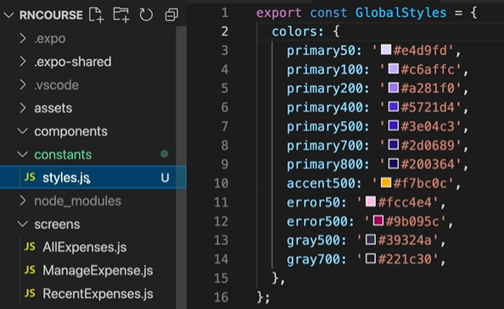
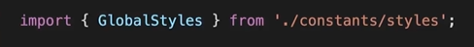
Adding Global Colors & Editing Navigation Configuration
- Create a new file called styles.js
- Define an object that holds your color values. Each key-value pair represents a color
- Import GlobalStyles wherever you need to use global colors
How to create global colors?
#1 Navigation Setup

Slide 11
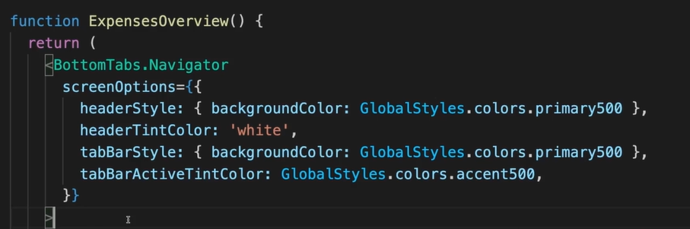

Adding Global Colors & Editing Navigation Configuration
This code add the style for the BottomTabs
#1 Navigation Setup

Slide 12
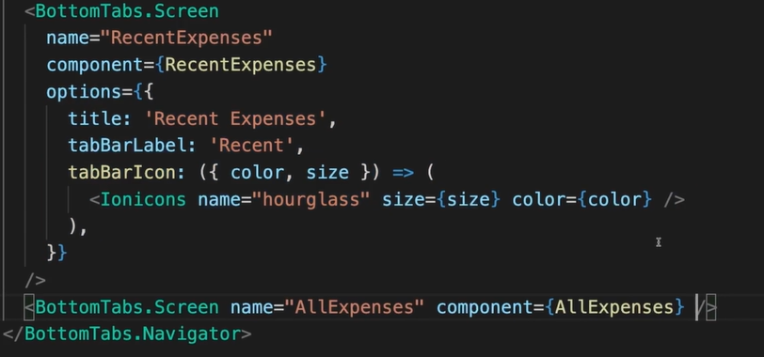
Adding Global Colors & Editing Navigation Configuration
To add the style for each Screen, you can add the code after “ component”. For example this code add style for Recent Expenses Screen.
#1 Navigation Setup

Slide 13

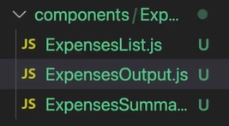
Creating Key App Components to Display Expenses
Create 3 file js in components:
ExpensesList
ExpensesOutput
ExpensesSummary
#2 App components creation

Slide 14
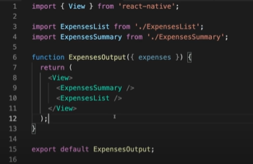
Creating Key App Components to Display Expenses
The ExpensesOutput will combine 2 components and show us a list with text about the expenses
#2 App components creation

Slide 15
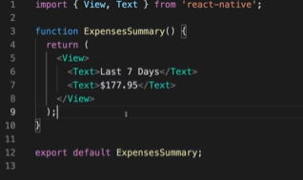
Creating Key App Components to Display Expenses
The ExpensesSummary will hold the text, show the expenses we spend
#2 App components creation

Slide 16
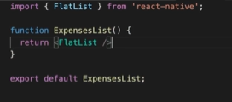
Creating Key App Components to Display Expenses
The ExpensesList function will create a list which shows all the expenses
#2 App components creation

Slide 17

Continuing Work on the Expense-related Components
The expenses should not be a number but an object consist of number and name that receive inputs from users. So we will update the component
#2 App components creation

Slide 18
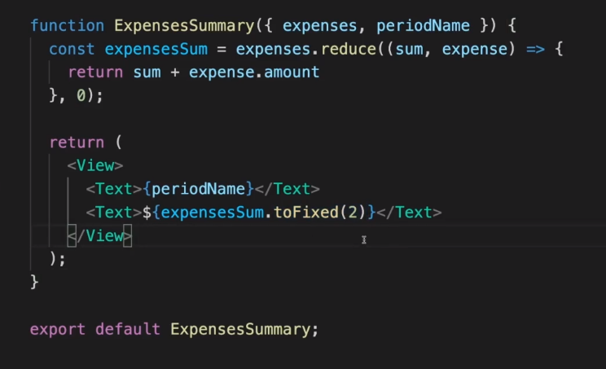
Continuing Work on the Expense-related Components
-The expensesSum calculates the summary of expenses during the period
-TheExpensesSummary will return the periodName and the expenses during the period
-toFix(2) is a method to retain 2 decimals
#2 App components creation

Slide 19
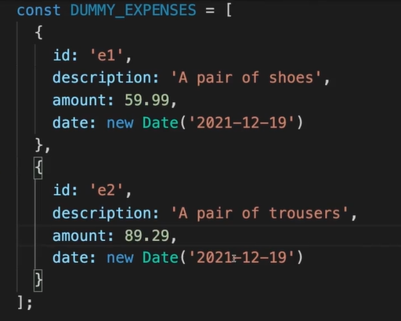


Adding Dummy Expense Data
The Dummy_Expenses is an array which hold the informations about the expenses
#2 App components creation

Slide 20
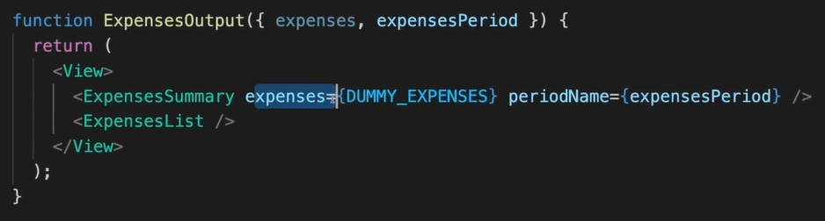
Adding Dummy Expense Data
Then we can use the Dummy_Expenses as a value for the expenses
#2 App components creation

Slide 21
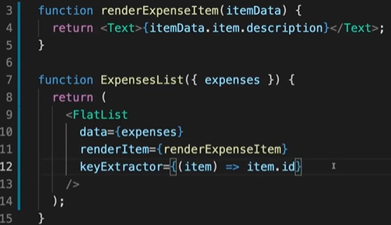
Outputting a List of Expenses
Pass parameters to prop
- Prop data of <FlatList> is assigned by array expenses.
- Prop renderItem is assigned using the renderExpenseItem function, specifying how each item in the list is displayed.
- Prop keyExtractor specifies how to get the unique key for each item
#2 App components creation

Slide 22
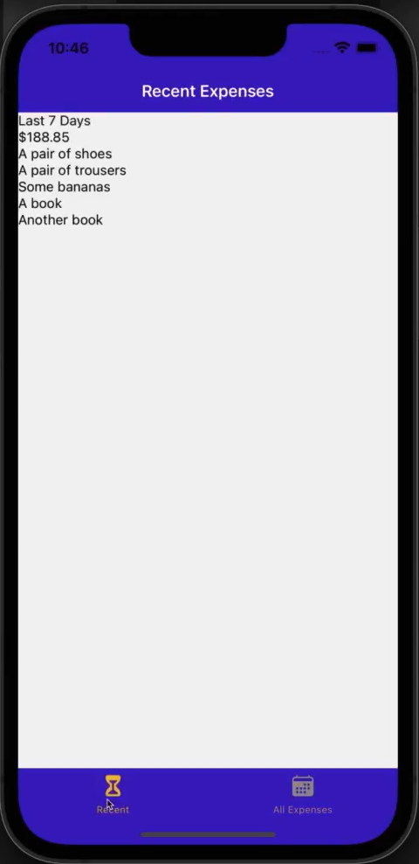
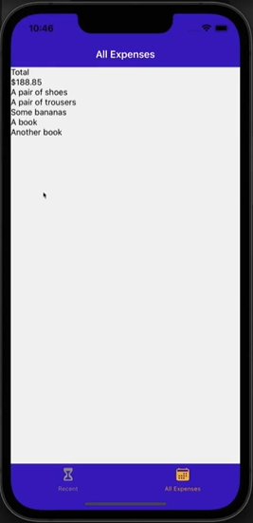
Outputting a List of Expenses
#2 App components creation

Slide 23
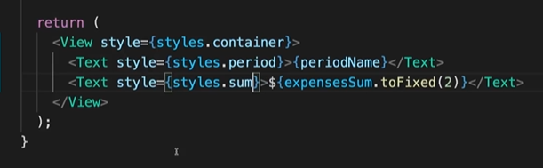
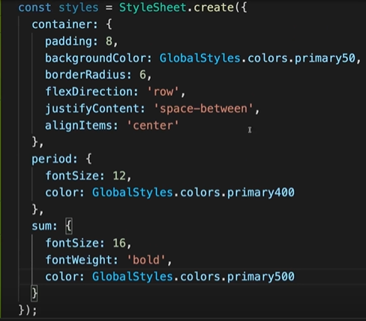
IMPROVING APP LAYOUT & STYLING
Set up Expense Summary and adding some styling
#3 Layout & Styling

Slide 24
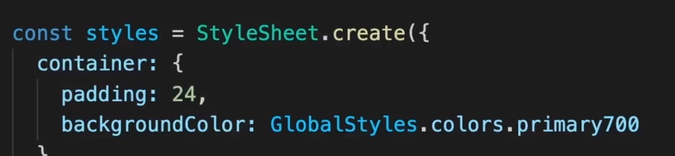
IMPROVING APP LAYOUT & STYLING
Adding styling to ExpenseOutput
#3 Layout & Styling

Slide 25
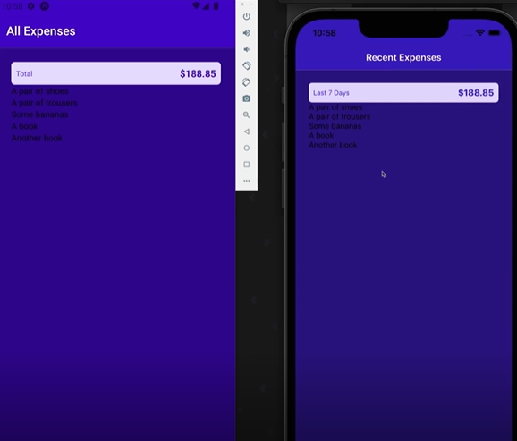
IMPROVING APP LAYOUT & STYLING
Screen after changing style
#3 Layout & Styling

Slide 26
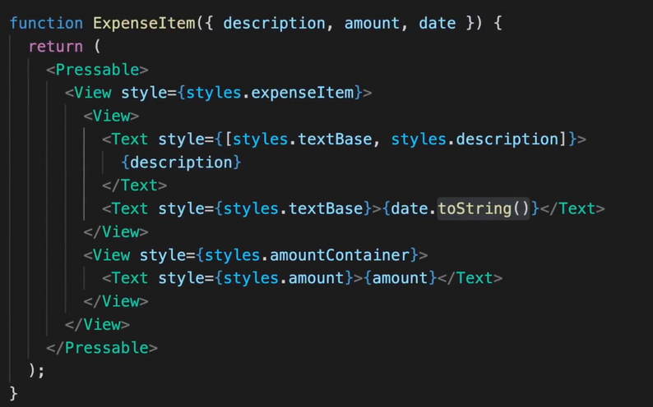
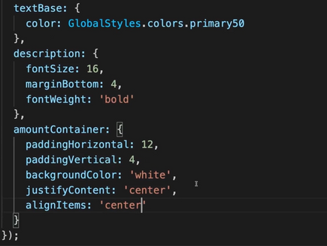
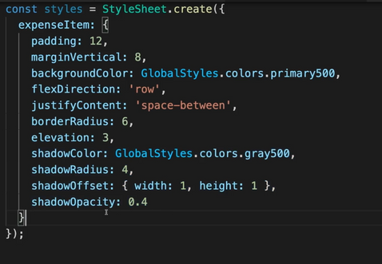
WORKING ON EXPENSE LIST ITEMS
style ExpenseItem component
set up ExpenseItem component
#3 Layout & Styling

Slide 27
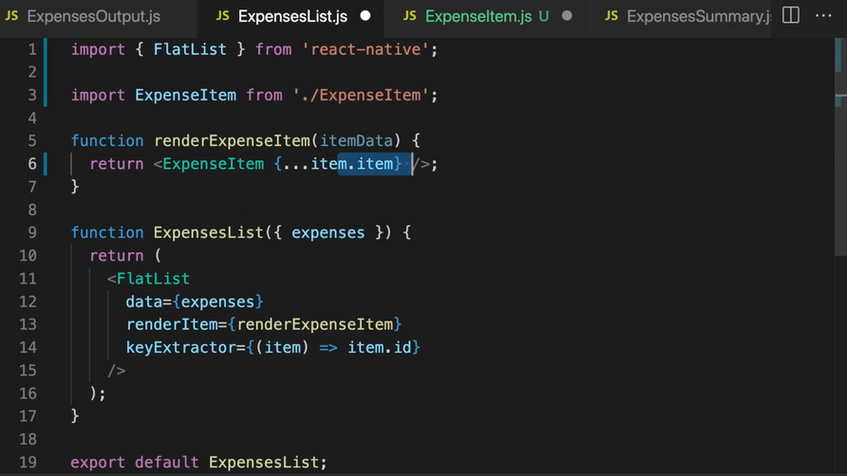
WORKING ON EXPENSE LIST ITEMS
Add ExpenseItem to ExpenseList
#3 Layout & Styling

Slide 28
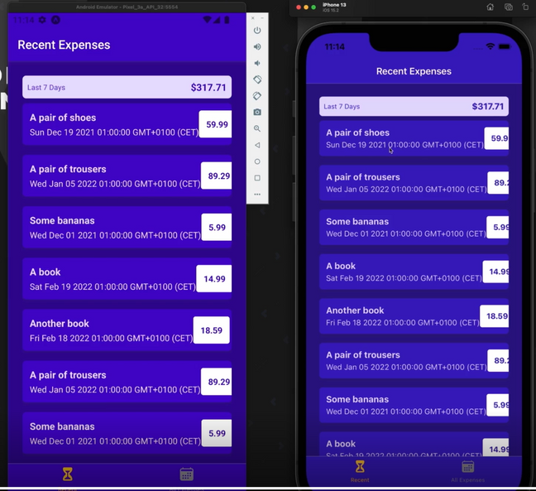
WORKING ON EXPENSE LIST ITEMS
The screen after adding some details
#3 Layout & Styling

Slide 29
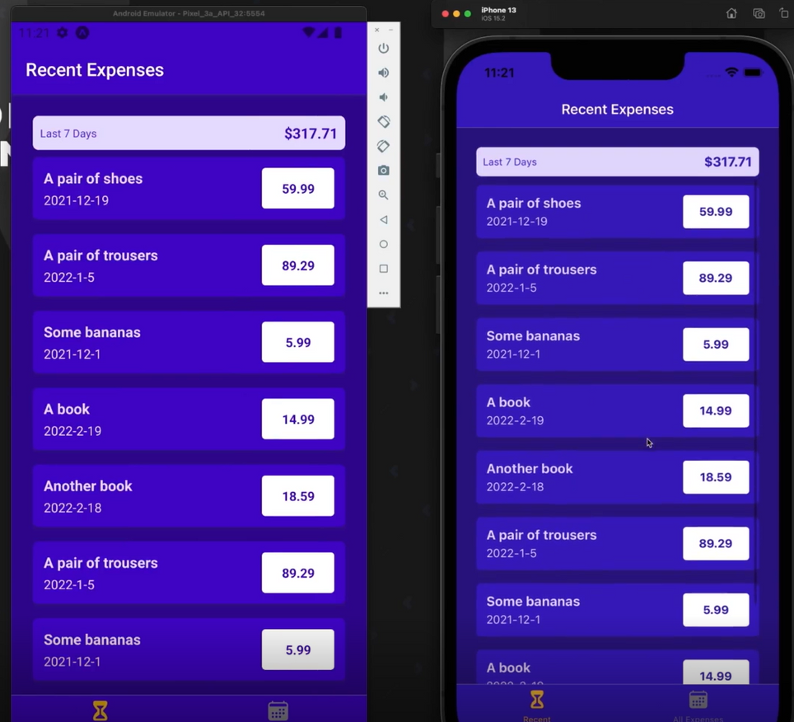
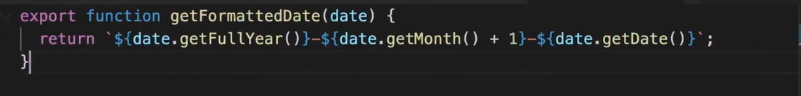
FORMATING DATES
The function in Date.js in folder Util using for updating the date. In the return function
we add plus 1 at “${date.getMonth}” for readable human
The screen after formating Dates
#3 Layout & Styling

Slide 30
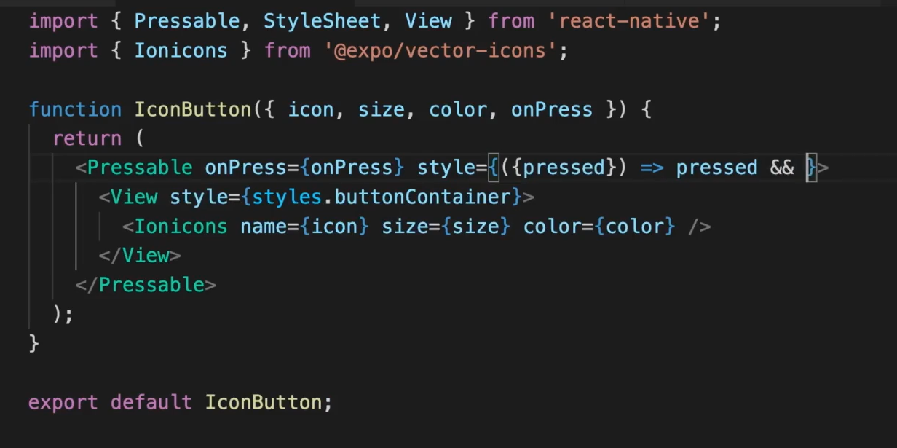
12. ADDING HEADER BUTTON AND MAKING ITEMS TAPABLE
Adding Icon button in components.UI.IconButton

Slide 31
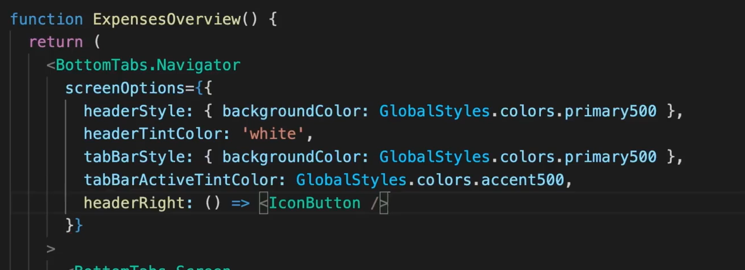
12. ADDING HEADER BUTTON AND MAKING ITEMS TAPABLE
Adding IconButton on App.js

Slide 32
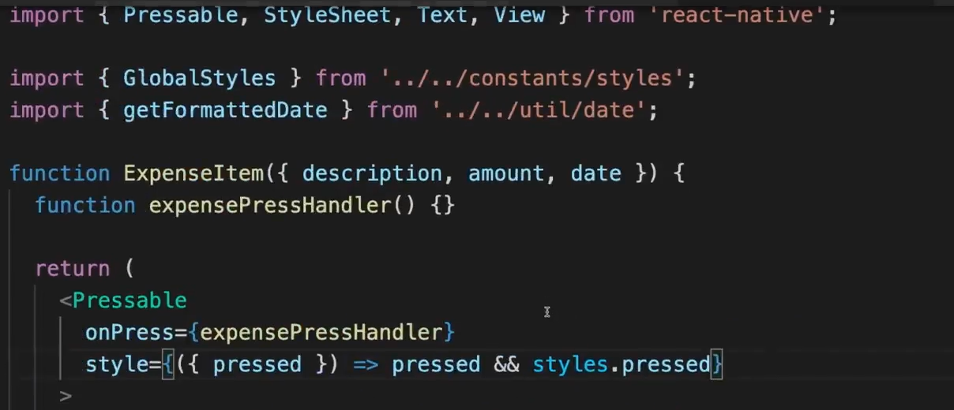
12. ADDING HEADER BUTTON AND MAKING ITEMS TAPABLE
Handle the press

Slide 33
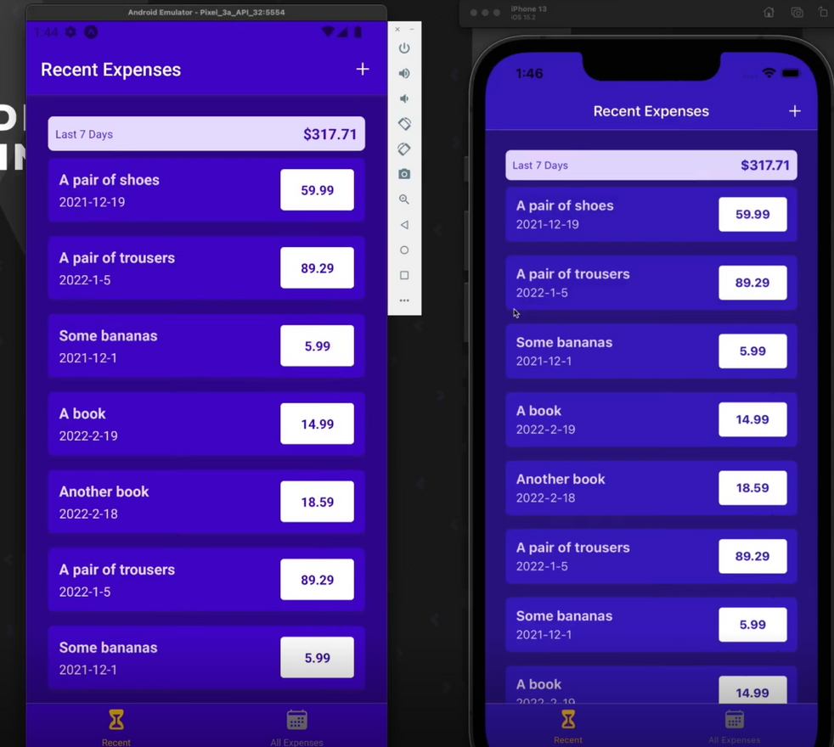
12. ADDING HEADER BUTTON AND MAKING ITEMS TAPABLE
The screen after adding header button

Slide 34
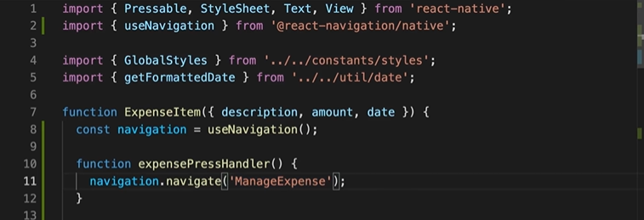
13. NAVIGATING PROGRAMMATICALLY BETWEEN SCREENS
Adding Navigation using useNavigation hook

Slide 35
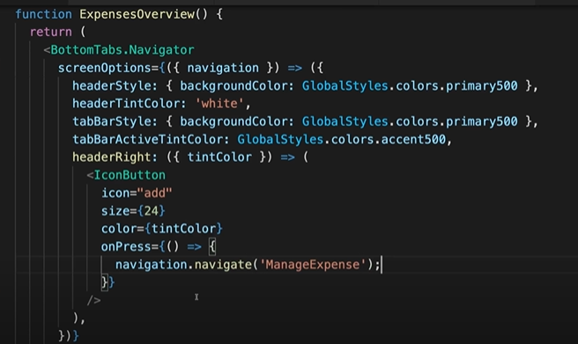
13. NAVIGATING PROGRAMMATICALLY BETWEEN SCREENS
Adding navigation to IconButton

Slide 36
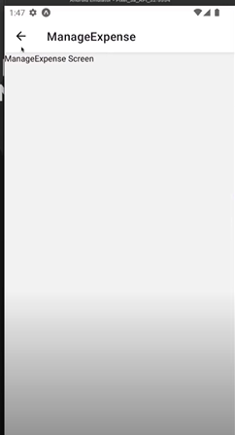
13. NAVIGATING PROGRAMMATICALLY BETWEEN SCREENS
The Navigating screen

Slide 37
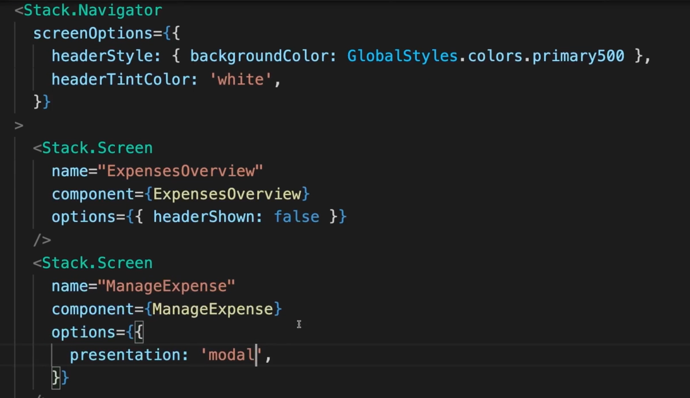
14.STYLING THE EXPENSE MANAGEMENT SCREEN
Adding screens in App.js

Slide 38
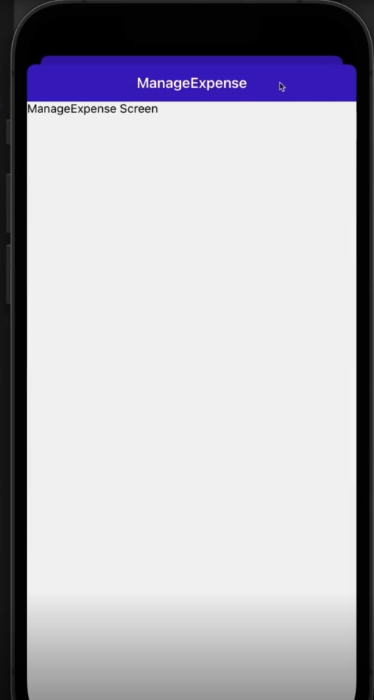
14.STYLING THE EXPENSE MANAGEMENT SCREEN
The updated screen after press on “Plus” icon

Slide 39
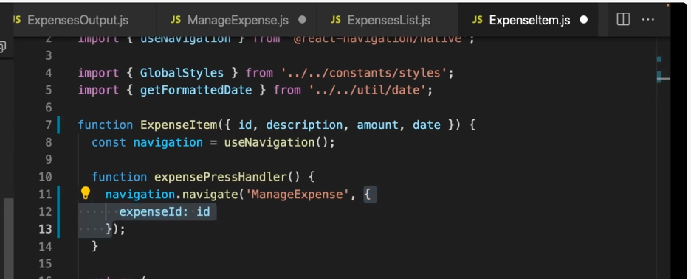
15. Supporting different editing modes and using route parameter
In ExpenseItem.js, create second parameter value - expense ID

Slide 40
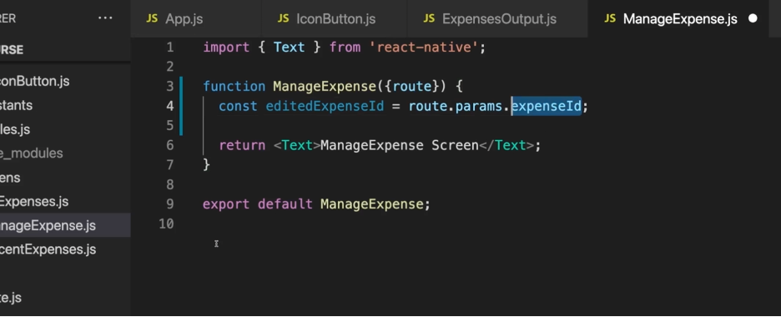
15. Supporting different editing modes and using route parameter
In ManageExpense.js, extract that parameter
and add route props to extract id.

Slide 41
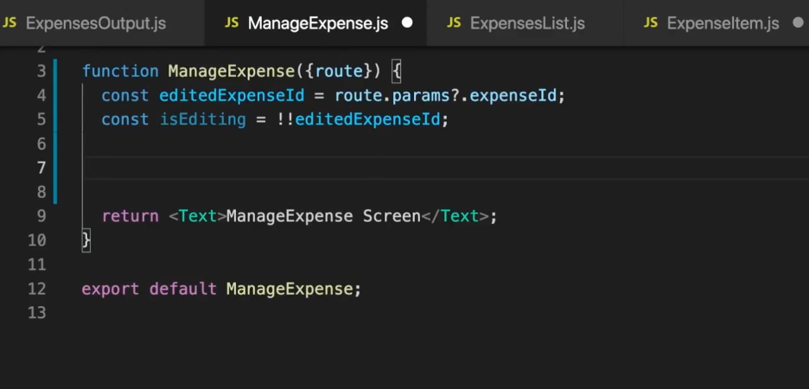
15. Supporting different editing modes and using route parameter
In ManageExpense.js, build conditional operator to check params

Slide 42
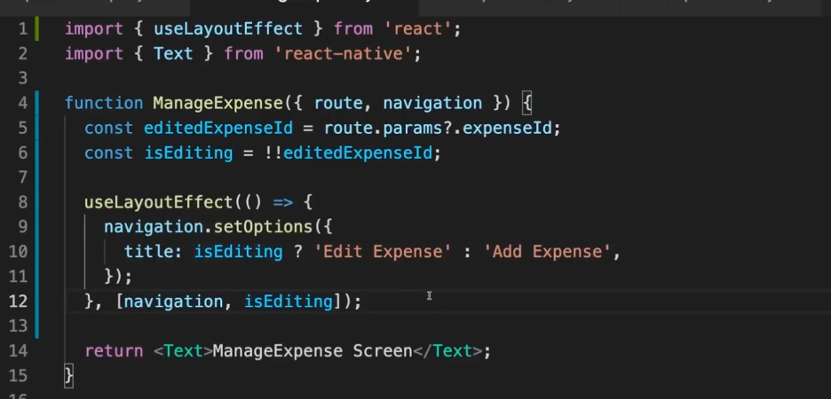
15. Supporting different editing modes and using route parameter
Set title in the header using useLayoutEffect

Slide 43

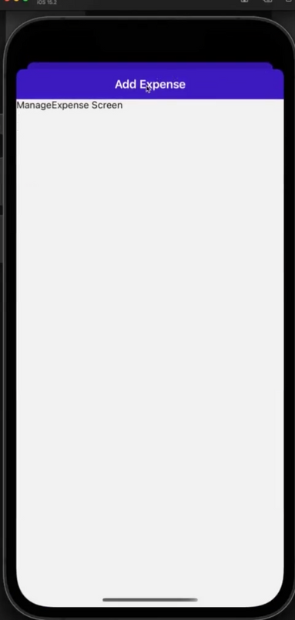
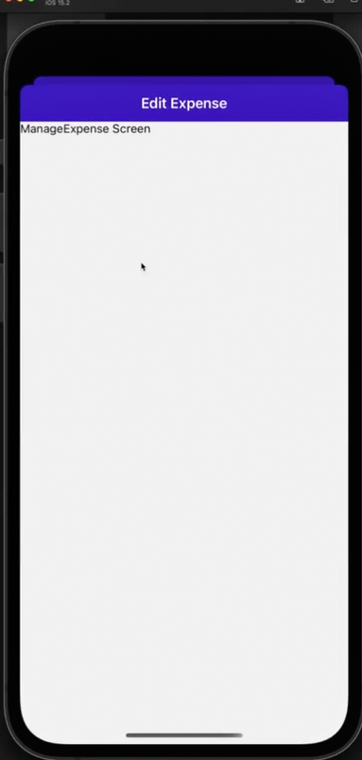
15. Supporting different editing modes and using route parameter
Result

Slide 44



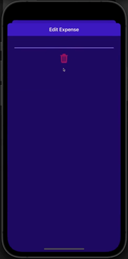
16
Add a delete button
Purpose: to delete an expense added
Location: in the ManageExpense screen
Expexted result:

Slide 45

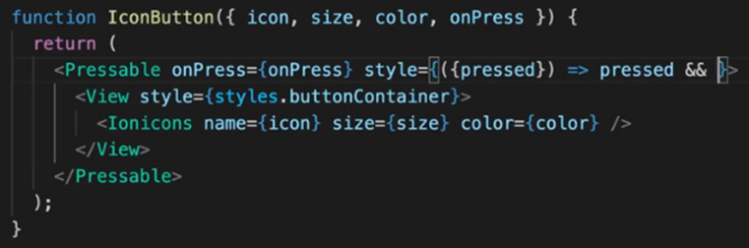
16
Add a delete button
How:
Make use of IconButton
give it 4 props

Slide 46
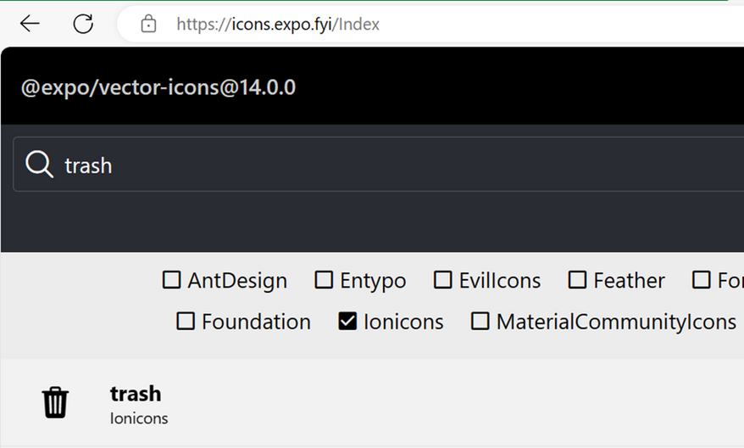
16
Add a delete button
4 props:
icon: “trash” from @expo/vertor-icons library
import the library:

Slide 47
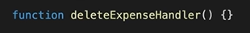

16
Add a delete button
4 props:
size: 36 pixels
onPress: create deleteExpenseHandler() function
Implementation:

Slide 48

16
Add a delete button
add styles for the whole screen and for the View wrapping the button:

Slide 49



Delete button result
16

Slide 50

17
Add custom button - confirming and cancelling
Create file - Button.js in UI folder

Slide 51

17
Adding custom button
Add function Button with 4 props:
children: storing content
onPress: function created from outside
mode: if the button in flat mode or not
style: additional styling

Slide 52

17
Adding custom button
Inside return, handle the props as follow:

Slide 53

17
Adding custom button
Add styles for button:

Slide 54

17
Adding custom button
Add two buttons (Cancel and Update/Add) inside ManageExpense screen with onPress props set to 2 functions cancelHandler and confirmHandler

Slide 55

Result
17

Slide 56

18
Closing A Modal Programatically
the ManageExpense screen should be automatically closed after clicking any buttons just created
-> Add “navigation.goBack()”

Slide 57

Result
18

Slide 58


19
Managing App-wide State with Context
We will use Context API to manage expenses
Step 1: Create state folder
create expenses-context.js file
import createContext from react
create an expense context from createContext() function.

Slide 59

19
Managing App-wide State with Context
Step 2: pass value to createContext()
expenses array holds the list of expenses.
addExpense function
deleteExpense function
updateExpense function.
Their name shows their purposes and take props shown as below

Slide 60

19
Managing App-wide State with Context
Step 3: Create ExpensesContextProvider function
ExpensesContextProvider function returns <ExpensesContext.Provider> component, which takes prop children and display it

Slide 61

19
Managing App-wide State with Context
Step 4: use useReducer() hook for complex state management
Define expensesReducer() function for the useReducer() hook. It takes prop state and action automatically
->check the type of action by switch statement for different cases: add, update, delete, and default

Slide 62

19
Managing App-wide State with Context
Step 4: use useReducer() hook for complex state management
->connect expenseReducer() and useReducer() in the ExpenseContextProvider function:
UseReducer return an array with 2 elements:
+expensesState: state managed by expenseReducer
+dispatch function: we can execute to dispatch a new action to the reducer function to manipulate the state

Slide 63

19
Managing App-wide State with Context
Step 5: Manage state using dispatch function
->add action type, and payload which is data into dispatch

Slide 64

19
Managing App-wide State with Context
Step 6: Add logic in reducer function
Example: in addExpense(): Return new array that add action.payload (new expense data) into the existing array
Similar to 2 remaining cases

Slide 65

20
Using context from inside components
Step 1: Construct value object
In expenses-context.js
Construct value object to bundle all our value data and functions together
+expenses key points to expensesState
+addExpense key points to addExpense function
Similar to deleteExpense and updateExpense

Slide 66

20
Using context from inside components
Step 2: set value prop
set value prop on the ExpensesContext.Provider component equals to value object just created

Slide 67

20
Using context from inside components
Step 3: wrap all navigation container with Custom Context
Go to App.js and wrap all navigation container with Custom Context

Slide 68

20
Using context from inside components
Step 4: Get our expenses from Context in AllExpenses.js and RecentExpenses.js
In AllExpenses.js:
+use useContext() hook to tab into ExpenseContext, we get expensesContext (expensesCtx)
+ add to expenses prop of ExpensesOutput component all expenses as follow:

Slide 69

20
Using context from inside components
Step 4: Get our expenses from Context in AllExpenses.js and RecentExpenses.js
In RecentExpenses.js:
Create expensesCtx the same way as in AllExpenses, filter to get recent expenses, for example in 7 days, as follow:

Slide 70

Result
20

Slide 71


21
Deleting & Updating Expenses
Delete expenses
In ManageExpense.js, in deleteExpenseHandler() function, we wanna trigger deleteExpense() function created in expenses-context.js
->to do that we need to access to context.

Slide 72


21
Deleting & Updating Expenses
Delete expenses
In ManageExpense.js
+pass ExpensesContext to useContext() hook, and store a constant expensesCtx
->call it in deleteExpenseHandler(), and pass it an id

Slide 73

Deleting Result
21

Slide 74

21
Deleting & Updating Expenses
Add/Update expenses
In confirmHandler(), check if we’re editing or updating and call methods accordingly
(The next step will be handle in the next section)

Slide 75

22
Finishing Touches
Handle status bar and fall back text when we have no expenses
->create text to render when there’s no expense in ExpensesOutput.js:

Slide 76

22
Finishing Touches
Handle status bar and fall back text when we have no expenses
->set the style of StatusBar ‘light’ to force it to be white color

Slide 77

Result
22

Slide 78





